Slide 1
WORKSHOPS
With Dr. Nancy Wayne

Slide 2
The Competence/Confidence Conundrum
and Overcoming Imposter Syndrome
Nancy Wayne, PhD
Professor of Physiology
Associate Vice Chancellor for Research
University of California – Los Angeles

Slide 3
WORKSHOP OBJECTIVES
Understand the ramifications of gender differences in confidence levels and its impact on educational and career outcomes
Identify signs and symptoms of Imposter Syndrome
Positive problem solving:
Identify your skills
Promote your skills in order to get recognition
Formulate strategies to attenuate feelings of inadequacy and stop feeling like an imposter

Slide 4
“Confidence is the stuff that turns thoughts into action.”
Richard Petty
Professor of Psychology
Notes:
Sometimes fear is a motivator for action.

Slide 5
Confidence Problems in the STEM Fields
Competent women underestimate their test scores on exams
Competent women’s lack of confidence cause them to leave STEM fields
Both men and women believe that women make poor leaders, leading to gender bias in leadership
Women don’t negotiate salary

Slide 6
Confidence Problems in the STEM Fields
Competent women underestimate their test scores on exams
Competent women’s lack of confidence causes them to leave STEM fields
Both men and women believe that women make poor leaders, leading to gender bias in leadership
Women don’t negotiate salary
NEGATIVE OUTCOMES:
Well educated, talented women won’t get ahead in the workforce, and when they do it’s for less salary than men.

Slide 7
Confidence Problems in the STEM Fields
Competent women underestimate their test scores on exams
Competent women’s lack of confidence cause them to leave STEM fields
Both men and women believe that women make poor leaders, leading to gender bias in leadership
Women don’t negotiate salary
NEGATIVE OUTCOMES:
Well educated, talented women won’t get ahead in the workforce, and when they do it’s for less salary than men.
LET’S LOOK AT SOME DATA …

Slide 8
Gender differences in estimating scores on exams in STEM fields
Male and female students are equally competent, but women significantly underestimate their test scores –
men overestimate their scores

Slide 9
Females underestimate and males overestimate math test scores
*
*
Dahlbom et al., Applied Economics Letters, 2010
Notes:
This study was performed on Swedish high school students – more females underestimated their math test scores, while more males overestimated their math scores. No gender difference in students that accurately assessed their scores.
Another study on Chemistry college students in the U.S. showed that more males are overconfident in their test scores than females.
Studies have consistently shown that confidence is important for labor market outcomes. The confident, and even overconfident, person will land the job, get the raise, get the promotion, get the corner office – frequently over that of a more competent person.

Slide 10
Females underestimate and males overestimate math test scores
Part of a larger problem known as STEREOTYPE THREAT
Definition: Fear that an individual‘s performance will justify a negative stereotype of whatever group with which the individual identifies. This fear affects performance in a direction that supports‘ the stereotype.
Stereotype: Girls/women are bad at math; therefore, they will do poorly at math because they believe the stereotype.
Spencer, Steele, Quinn (1999) Stereotype threat and women’s math performance. . Exp Soc Psychol.
Stereotype threat can be eliminated by creating an IDENTITY SAFE ENVIRONMENT.
Davies PG, Spencer SJ, Steele CM (2005) Clearing the air: Identity safety moderates the effects of stereotype threat on women‘s leadership aspirations. J Pers Soc Psychol

Slide 11
Competent women’s lack of confidence causes them to leave STEM fields
Confidence is often more important than competence in getting ahead in the workplace.
[caveat: confidence in men is considered an attractive trait; less so in women]

Slide 12
Lack of confidence leads COMPETENT women to leave engineering
*
**
**
*
*
Cech et al., American Sociological Review, 2011
Notes:
Women who begin college intending to become engineers are more likely than men to change their major and choose another career, but it's because they lack confidence, not competence.
GPA and SAT math scores were not significantly different; nor was the importance of raising a family.
However, there were significant differences in the students’ confidence in their engineering expertise and feelings that engineering was a good career fit. Ultimately, more women changed majors and career plans than men while in college.

Slide 13
Lack of confidence leads COMPETENT women to leave engineering
Negative consequences:
Engineering loses women from making possible important contributions to the field.

Slide 14
Gender Bias in Leadership
Both men and women believe that women make poor leaders – even though there’s evidence to the contrary.
Notes:
I have taught small group Problem Based session in Reproductive Physiology at the UCLA Med School since 1994. I ask each small group for a volunteer to lead the class in discussing the answer to the problem. In 2007 a student came up to me at the end of one of these sessions and said, “Dr. Wayne, did you notice that all of the group leaders were men? Is that typical?”
I decided to investigate and the following year I took notes on the gender of the group leaders. And it was true, disproportionately fewer women volunteered to be group leader than men. This is an example of Stereotype Threat. The stereotype is that women make poor leaders, therefore, men and women behave in a way that leads to fewer women becoming leaders.
I then designed a follow-up study for the following year to try to develop an Identity Safe Environment – shown on the next slide.

Slide 15
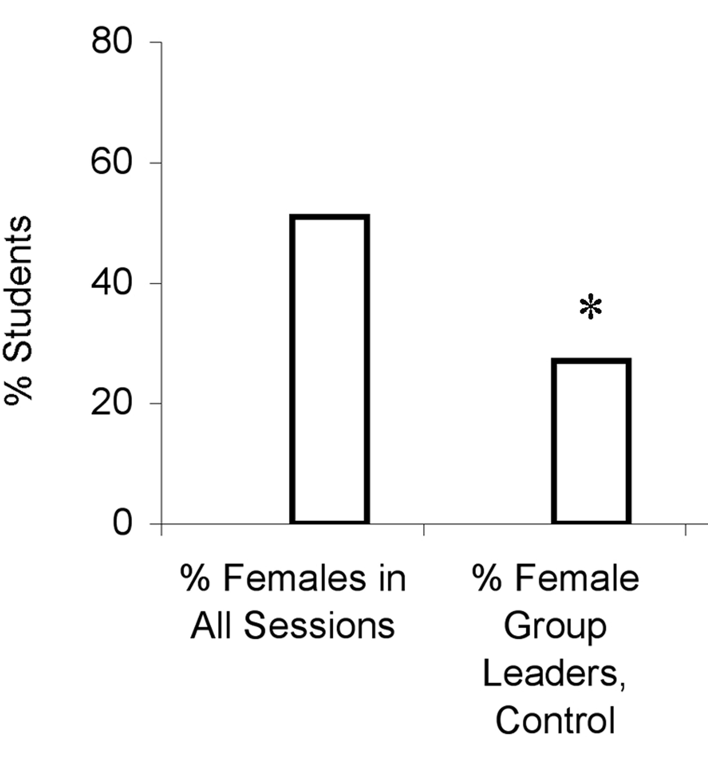
Disproportionately fewer female Medical Students take classroom leadership role
Wayne et al., Academic Medicine, 2010
Notes:
About 50% of the class is women – and we’ve had gender parity at UCLA for decades. One half of the class was given the typical Control instructions. Although there is gender parity in terms of numbers of medical students, disproportionately fewer women than men take on leadership positions in the small group setting.
The other half of the class received those same Control instructions PLUS a brief pep talk about the importance of trying out a leadership position in a non-judgmental environment.

Slide 16
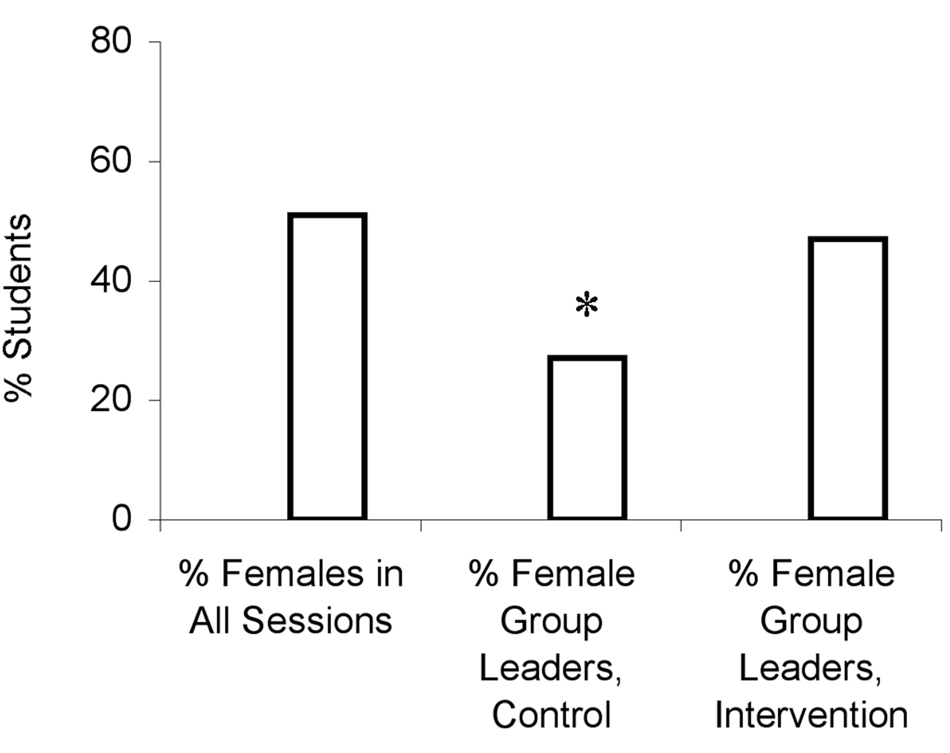
Disproportionately fewer female Medical Students take classroom leadership role
Wayne et al., Academic Medicine, 2010
Notes:
By creating an Identity Safe Environment in the Intervention group, the gender bias in classroom leadership was eliminated.

Slide 17
Disproportionately fewer female Medical Students take classroom leadership role
There is a strong link between perceived leadership ability and professional advancement in academic medicine.
When women are uneasy in leadership roles, be it in school or later in their careers, we are disenfranchising half of our population that has the potential to make significant contributions to the medical profession.

Slide 18
Women Don’t Negotiate
Men are 4x more likely to negotiate a starting salary than women.

Slide 19
Newly Trained female Physicians earn less than their male counterparts
Lo Sasso et al., Health Affairs, 2011
Notes:
Select data from the overall study. In every category, men were paid a significantly higher starting salary than women – including in specialties where women far out number men (Pediatrics, ObGyn). This pay gap is reflective of what’s been documented across all business and professional sectors.
Why? Gender discrimination? Gender differences in salary negotiations? This study didn’t analyze why. But work by Linda Babcock and colleagues showed in multiple business and professional sectors that women tend not to negotiate both a first salary and pay raises – has immediate and long-term implications.

Slide 20
The cost of not negotiating first salary
By not negotiating, a woman stands to lose more than $500,000 by age 60.

Slide 21
Imposter Syndrome
“I am always looking over my shoulder wondering if I measure up.”

Slide 22
Imposter Syndrome
“I am always looking over my shoulder wondering if I measure up.”
Sonia Sotomayor
U.S. Supreme Court Justice

Slide 23
Imposter Syndrome: A Problem of Confidence
Feeling like a fraud – that you’ll be “found out”
Feeling that your success and advancements are due to luck more than skill
Plagued by self doubt
In order to avoid detection as a fraud, you out-prepare and out-credential everyone else –mismatch between competence and confidence.

Slide 24
BUILDING CONFIDENCE TO OVERCOME FEELING LIKE AN IMPOSTER
Get your support system in place -- advisors, mentors, friends, partner.
Modified from K. Kaplan, Unmasking the Imposter, Nature, 2009

Slide 25
BUILDING CONFIDENCE TO OVERCOME FEELING LIKE AN IMPOSTER
Get your support system in place -- advisors, mentors, friends, partner.
Make a list of your strengths to remind yourself (and others) of your own accomplishments
ongoing curriculum vitae
Modified from K. Kaplan, Unmasking the Imposter, Nature, 2009

Slide 26
BUILDING CONFIDENCE TO OVERCOME FEELING LIKE AN IMPOSTER
Get your support system in place -- advisors, mentors, friends, partner.
Make a list of your strengths to remind yourself (and others) of your own accomplishments
ongoing curriculum vitae
Remind yourself that sometimes good enough is good enough.
Modified from K. Kaplan, Unmasking the Imposter, Nature, 2009

Slide 27
BUILDING CONFIDENCE TO OVERCOME FEELING LIKE AN IMPOSTER
Get your support system in place -- advisors, mentors, friends, partner.
Make a list of your strengths to remind yourself (and others) of your accomplishments
ongoing curriculum vitae
Remind yourself that sometimes good enough is good enough.
Be aware of your language choices. If you find yourself thinking you were ‘lucky’ to have received …
an ‘A’
a great job
a promotion
a grant or published a paper
… focus on what you did to earn it.
Modified from K. Kaplan, Unmasking the Imposter, Nature, 2009

Slide 28
Small Group Discussion
Discuss circumstances where you have felt inadequate or have been plagued by self-doubt at different stages in your career.
CONFIDENCE BUILDERS
What strategies have you used to ward off or attenuate the feeling of inadequacy?
What work-related skills do you excel at?
What can YOU do to promote your skills, get recognition for them, and turn that recognition into something of value to you (promotion, awards, speaker invitations, more research space, etc.)?
What can you do to get OTHERS to promote your skills?

