Slide 1
The Gendering of Access and Outcomes in Research,
Communications and International Collaboration
An ADVANCE roundtable
Lehigh University
March 19, 2013

Slide 2
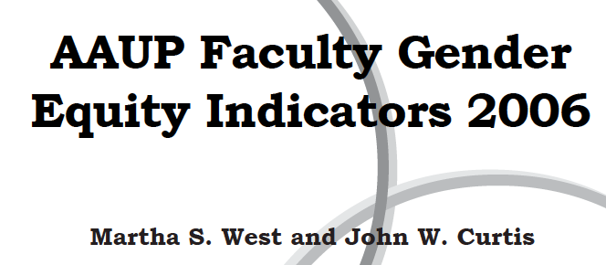
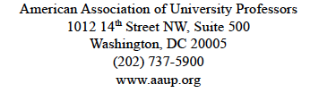
The gendering of the professoriate

Slide 3
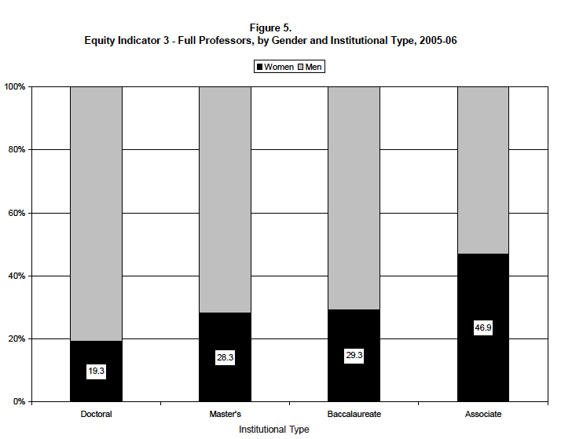

Slide 4
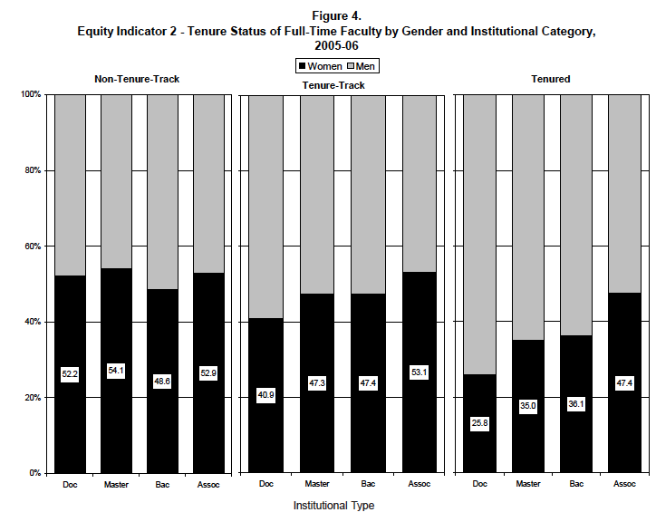

Slide 5
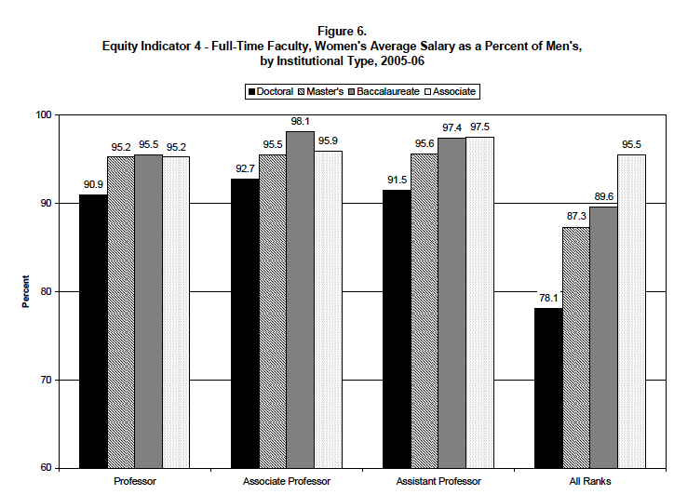

Slide 6
The gendering of research
Sex Differences in Application, Success, and Funding Rates for NIH Extramural Programs
  Jennifer Reineke Pohlhaus, PhD, Hong Jiang, PhD, Robin M. Wagner, PhD, MS, Walter T. Schaffer, PhD, and Vivian W. Pinn, MD
  Acad Med. 2011 June; 86(6): 759–767.

Slide 7
The gendering of research
Cross-sectional analysis = women and men were generally equally successful at all career stages
Longitudinal analysis = men with previous experience as NIH grantees had higher application and funding rates than women at similar career points.
Women received larger R01 awards than men
Men had more R01 awards than women at all points in their careers.
Therefore, further action will be required to eradicate remaining sex differences.

Slide 8
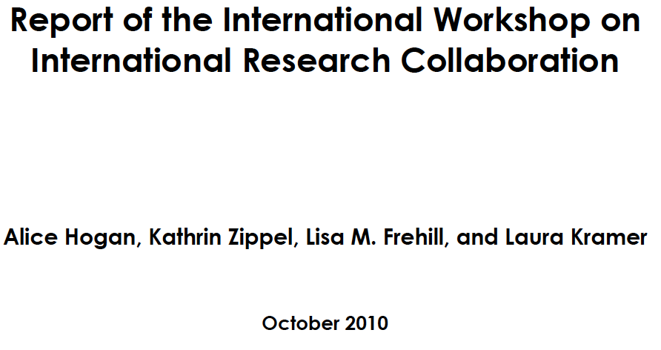
Gender and international research

Slide 9
Executive summary
For building international collaborations networking at conferences cannot be overstated
Women and minority men are less likely than whit males to engage in international collaboration
There is a wide variation in the recognition v=gven to international collaboration
For women the risk of sexual harassment and lack of support networks are particular concerns

Slide 10
Gendering of the media
mailto:http://chronicle.com/article/Woman-as-Academic-Authors/135192?subject=women and publications

Slide 11
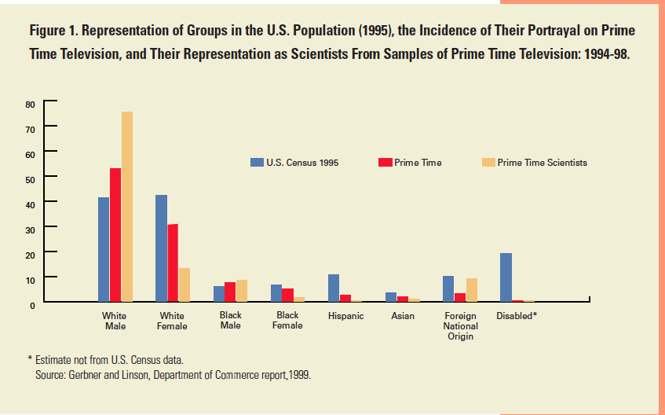
Gendering of the media

Slide 12
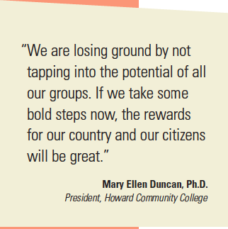
conclusions

